Slide 1

CS 483: Machine Learning
Week 14: Transformation and Dimensionality Reduction

Slide 2
Last module
[remind me]
We learned about handling text.
Specifically, we learned about how to process natural language text.
Most of the work is turning the text into a vector. All machine learning is based on vectors.
We learned about the bag of words representation for doing this.

Slide 3
This module
We're going to learn about dimensionality reduction. Why it's useful and one way to do it.
Specifically, we're going to learn a common and useful dimensionality reduction algorithm called PCA: principal component analysis
If you've ever wondered how people generate a 2D or 3D chart of a 100-dimensional phenomenon, this will be interesting.

Slide 4
Dimensionality
Dimensionality just means "number of dimensions"
We normally use this term when talking about the number of features.
Each feature is a column in our dataset. If we wanted to plot the dataset on a graph, we'd give each feature its own axis.
For example, we could plot this dataset in a 3D chart with Attack being X, Defence being Y, and Special being Z
Attack | Defence | Special
100 | 50 | 75
75 | 85 | 25
150 | 25 | 95

Slide 5
What makes dimensionality high?
Dimensionality is high when the number of features is high.
This is a good barometer for how complicated our dataset is.
In the previous table, it's clear that there's a relationship between attack and defence. Specifically, they seem to be inversely correlated.
Imagine if there were 100 stats instead of 3 in the previous table. Now we can't plot it anymore, and it's harder to find any relationships (correlations require a 100x100 matrix to find instead of a 3x3 one).

Slide 6
The curse of dimensionality
There's a common phrase you will hear in data science: the curse of dimensionality.
The curse is this: more dimensions = more bad
I would be more specific, but the curse is not specific. In general, a bunch of completely unrelated bad things start happening once the number of dimensions gets high.
We call datasets with these bad effects dimensionally cursed.
In this particular class on ML, you can actually call something "cursed" and have it be formal, scientific language.

Slide 7
Examples of the curse
We already talked about what happens with the correlations matrix. We used correlations to help us understand our dataset better and to choose good columns. The more columns, the harder it is to find a good subset. Remember project 2 and how it could be overwhelming.
It turns out, there's a rule of thumb in ML that you want about 5 training examples for every feature (obviously it varies a lot by dataset, this is a general pattern). This means the 3 feature dataset needs about 15, while the 100 feature dataset needs about 500.
In data mining, more features has a factorial effect on the number of possible correlations.

Slide 8
More examples of the curse
Clustering starts to have problems in high dimensional spaces if the data are uncorrelated. The more dimensions there are, the more distances all start to spread out and become meaningless. (technically this doesn't happen if the data is highly correlated).
Remember nearest neighbor? Once distances spread out, it gets a lot less useful. Basically the "nearest" neighbor is far away, and there are a bunch of similarly far away points that aren't necesssarily related at all.
This even happens in contexts outside of data science. For example: algorithms and data structures. Imagine doing path finding on a 2D map. Now imagine it on a 3D map. Suddenly it's an order of magnitude slower. Even though our path finding algorithms were pretty efficient.

Slide 9

Questions?

Slide 10
Fixing the curse
Okay, so more dimensions = more bad
So: reduce the number of dimensions! Easy.
You actually already have some experience with this.
Feature selection is one way to remove the curse. You just drop features you don't care about.
Remember how the house prices weren't so great with logistic regression if you just threw a huge number of columns at it, but then when you selected more relevant columns and threw out the others, it improved the performance?

Slide 11
It's counter intuitive
Wasn't that strange?
I thought more data was better!
Well, not if it's correlated, noisy, or misleading.
Removing columns is fine, but it's very manual.
It's also very binary. What if 3 columns are very correlated? Which one do we keep?
What if there were a way to create a new, synthetic column that kind of combines them?

Slide 12
Principal component analysis
This is what principal component analysis lets us do
It creates new features that are linear combinations of the other features.
These new features can represent things like "half of attack plus 2 times defence and 3 times special".
It also gives us a way to evaluate how important each feature is. Some of the features will explain the data better than others, as we will see.

Slide 13
How are these features useful?
At first glance, this seems kind of weird
Like, we're trading something really concrete ("attack") for something less concrete ("half of attack plus 2 times defence and 3 times special").
Why bother?
Well, let's look at our data again.

Slide 14
Looking at the data
Attack​ | Defence​ | Special​
100​ | 50​ | 75​
75​ | 85​ | 25​
150​ | 25​ | 95​
Notice that the more attack we have, the less defence we have.
And also notice, the more attack we have, the more special we tend to have, too.
We could imagine transforming this data into a single feature: "offsensive orientation".
The more offensively oriented an instance is, the higher its attack and special is and the lower its defence.

Slide 15
Another benefit
When we create these new dimensions, we can choose how many.
For example, we can keep the two best ones.
That means we can plot any dataset on 2 dimensions. We just pick the 2 most explanatory dimensions.
If those dimensions are good, not only can we make a scatter plot of our data, but the dimensions will be maybe more explanatory than the ones we had before.
This is what principle component analysis (PCA) is all about.

Slide 16
Questions?

Slide 17
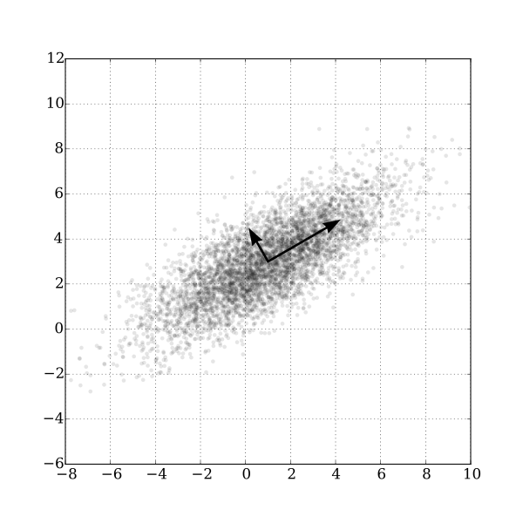
Example
Here's an illustration of PCA.
It's a scatterplot.
Notice that there's a clear direction of the trend.
One of the "new axes" points in the direction of the trend. This axis is super useful.
The other axis is less useful. It tells us how far away we are from the first axis.
Image: author: Nicoguaro , license: CC-SA 4.0.

Slide 18
Example (2)
Why is the first axis so useful?
Because it explains most of the variance of the data.
What does that mean?
It means that if we look at how the data is spread out, the first axis points in the direction of maximum spread.
Why does that matter?
Image: author: Nicoguaro , license: CC-SA 4.0.​

Slide 19
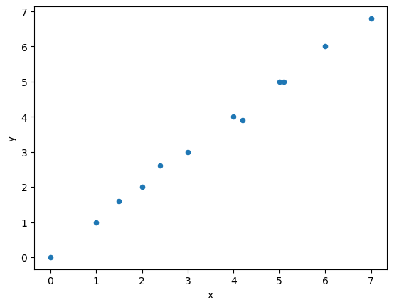
More spread = more important
Consider this dataset.
It's almost a line. We could almost replace it with a 1-dimensional chart by rotating it.
The second axis (the one perpendicular to the line) gives us barely any information at all. It tells us how much a point slightly deviates from the line.

Slide 20
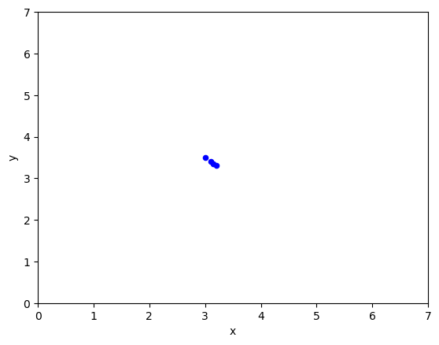
More spread = more important (2)
If we ignored the good axis, how much information would we lose?
To ignore an axis means to project all the points onto the other axes. So imagine we project all the dots onto the smaller vector.
They'd be all bunched up.
We would have lost a ton of information. The line is clearly important, and we deleted it.

Slide 21
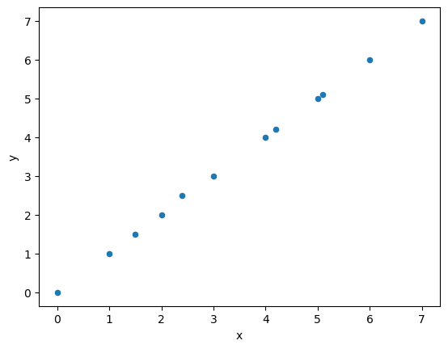
More spread = more important (3)
But what happens if we delete the other one?
Almost nothing (the right graph is just a line):

Slide 22
Kind of like compression
What we're really doing here is a kind of lossy compression.
We're trying to delete axes that don't really change the data that much.
Imagine we deleted that second axis. It's hard to even see the difference. But now, we can store each point with just 1 number instead of 2 (the first axis tells us how far we are along a line, but the line can be stored with 2 numers).
So we got almost 50% compression with barely any noticeable change in the dataset.
In fact, this technique is used in actual compression.

Slide 23
Questions?

Slide 24
Eigenvalues / eigenvectors
Unfortunately, PCA is based off eigenvalues and eigenvectors.
I found eigenthings (my word for both eigenvalues and eigenvectors) to be very challenging to understand. The main problem was just understanding "what's the point?".
And it's very important to understand them.
Let's do a review real quick, since we might not remeber them from linear algebra.
[Can anyone give me some cliff notes to start with? What are eigenvalues and eigenvectors?]

Slide 25
Eigenvalues / eigenvectors (2)
An eigenvector is a vector that is special: if we multiply a matrix by an eigenvector, it ends up being equivalent to multiplying the vector by a plain old scaler.
This is often stated like this: Ax = λx
A is a matrix, and lambda is a scalar.
But why does this matter? It doesn't really help us until we think about what matrix we want the eigenvalues/vectors from.

Slide 26
The correlation matrix
Remember how we looked at a table of correlations earlier in the semester, with the house price dataset?
That was a correlation matrix. It let us say "house price is 0.75 correlated with square footage".
Remember that Pearson Correlation is a number between –1 and +1. A correlation of 1 means that feature A and feature B go in exactly the same direction. –1 means they go in opposite directions (inverse correlation). 0 means they are uncorrelated, and you can't really draw a correlation line at all—it's more of a cloud.

Slide 27
Non-transformation matrices
The correlation matrix is not a transformation matrix, but we can pretend it is one to help us understand its eigenthings.
It's easier to understand eigenthings for transformation matrices. If the wind is a transformation, the blade of grass that doesn't bend (because it's pointing in the right direction) is an eigenvector.
So, let's pretend that we multiply an instance in our dataset by the correlation matrix. What happens to it? [thoughts?]

Slide 28
Example
This is a correlation matrix for a dataset.
Feature A and B are perfectly correlated, but both are uncorrelated with C: 1 1 0 1 1 0 0 0 1
What happens if we multiply a correlated instance by that? <10, 10, 10> * C = <20, 20, 10> <-- bigger, and changed direction.
What if the instance is closer to the real correlation? <10, 10, 1> * C = <20, 20, 1> <-- almost did not change direction at all.
What if the instance has the same correlation as the correlation matrix? <10, 10, 0> * C = <20, 20, 0)> <-- identical direction, only got bigger.

Slide 29
Correlation matrix as transformation matrix
That's what a correlation matrix does. It makes your data more correlated (or anti-correlated). The amount that it gets more correlated is based on how correlated the features are in the correlation matrix.
Note: we never want to actually do this. We will never multiply anything by the correlation matrix. But it's hard to understand its eigenvalues without understanding what it does as a transformation.
If your data does not match the correlations, it moves it a lot in the direction of matching the correlations.
If your data already matches the correlations, it doesn't change its direction, it just gets bigger.

Slide 30
Eigenvectors of the correlation matrix
That's the key: if you multiply data that matches the trend (it's correlated the same way as the correlation matrix) then its direction doesn't change.
What do we call that kind of vector?
Yes, an eigenvector. Therefore, one of the eigenvectors of the correlation matrix will point "in the direction of the trend/correlation"
And the amount that it gets multiplied in the direction of the correlation? That's the eigenvalue. The bigger it is, the better (more linear) the correlation.

Slide 31
Why all of this matters
Because of this, the eigenvector with the biggest eigenvalue will tend to point in the direction of the line.
This is the most meaningful way we have of describing the line. Specifically, it will explain most of the variance of the dataset.
That's ultimately the goal. We're trying to create "new" dimensions that explain as much of the varience (spread) as possible in the data. We want wide axes where the data is as spread out as possible. That gives us the most descriptive power.
The eigenvalues tell us how much spread we are capturing with each eigen vector..
In fact, there will be more than one eigenvalue.

Slide 32
Why all of this matters (2)
The other eigenvectors will be orthogonal (why? Because of something called the spectral theory. Symmetric matrices have orthogonal eigenvectors, and the correlation matrix is symmetric)
This means we can break our data down into new, more useful dimensions (like dimensions that point along trendlines).
And then, delete the ones we don't care about!
This is how we do dimensionality reduction. We define new dimensions, measure how much spread each one has, and delete the ones with the least spread.

Slide 33
Remember: more spread = more important!

Slide 34
Principle components
Imagine we have 100 dimensions instead of 2.
And imagine we want to create 100 new orthogonal dimensions so that we capture the spread better (using eigenvectors).
We can decide to keep the top 10 best ones.
These dimensions are called: Principal Components. They are the 10 best components of our eigenvector matrix for describing the data.
Principal Component Analysis (PCA) means finding these components.

Slide 35
Interpreting its eigenvalues
What are the eigenvalues/eigenvectors of this matrix?
Well, if the matrix is mostly linearly correlated, then the eigenvalues tell us some interesting things.
First of all, notice that the correlation matrix is guaranteed to be symmetric. It will always be symmetric, because correlation is symmetric (if feature A is 0.79 correlated with feature B, then feature B is 0.79 correlated with feature A).
This comes from the spectral theory. The spectrum of a matrix is the set of its eigenvalues. A matrix that is symmetric is guaranteed to have real eigenvalues and the eigenvectors will be orthogonal.

Slide 36
Who cares about orthogonal eigenvectors?
If the eigenvectors are orthogonal, some interesting things happen.
First, we end up with one of the eigenvectors pointing roughly in the direction of the trend. Kind of like a best-fit line (but not guaranteed to be the actual best fit line).
Why? Because if the correlations are really close to 1 or –1,

Slide 37
Questions?

Slide 38
Doing PCA
So, we've basically already done principle components analysis.
Here's what you do:
Compute the correlation matrix for the table
Get the eigenvalues and eigenvectors of it
Sort the eigenvectors by their eigenvalues
Choose the top N, where N is the number of dimensions you want. (alternatively, keep taking dimensions until you have the percent of variance that you're looking for)

Slide 39
Doing PCA
5. Make a matrix with the best eigenvectors as its columns. Each column is one eigenvector.
6. Standardize your data. Subtract the mean and divide by stdev for each instance. (in the earlier example I didn't do this, but I didn't have to because the mean was 0. that probably won't be the case for you). You may not need to divide by stdev, but it's easy to do both it in one operation in SKLearn.
7. Multiply each instance with this vector. Because the vector is not square, the results you get back will have fewer dimensions. This is what we want.
Congratulations, you have removed dimensions without destroying your data quality (probably)!

Slide 40
The code
Let's do it by hand so that we know what SciKit learn is doing.
Then we'll see how easy it is to use PCA in SKLearn using their pre-built class for it. This is what you will actually use when using PCA.
First, we need some data:
import pandas as pd COLUMNS = ['attack', 'defense', 'special att.'] data = pd.DataFrame([ [100, 50, 75], [75, 85, 25], [150, 25, 95], [50, 45, 45], [80, 40, 35], [80, 50, 35], [125, 65, 85], ], columns = COLUMNS )

Slide 41
The code (2)
Now we need to use numpy for some linear algebra: import numpy as np import numpy.linalg as la
Pandas has a "corr" method to get the correlation table. And "to_numpy" will turn the table into a numpy array: a = data.corr().to_numpy()
Now, we can use the library to compute eigenthings (using numerical techniques) for the correlation matrix: eig_values, eig_vectors = la.eig( a )
Computing exact eigenvalues requires computing determinants and solving non-linear systems of equations. Too slow. We use libraries that give us close approximations instead.

Slide 42
What do we get?
Here are the results for the sample dataset: (eig_values, eig_vectors) == (array([2.11154986, 0.13313921, 0.75531093]), array([[-0.62669206, 0.68032136, 0.38002619], [ 0.43057498, -0.1041635 , 0.89652393], [-0.64950924, -0.72547419, 0.22765091]])) Notice: the eigenvalues are skewed. The first one is bigger. In fact, the first eigenvector (the first column in the matrix) explains about 70% of the variance.
We get how much variance is explained for a vector by dividing its eigenvalue by the sum of all the eigenvalues. In this case: 2.11154986 / 3 = 96.67
The second vector only explains 0.13313921/3 = 4.4%
It's not a coincidence that the eigenvalues sum to 3. They will sum to the number of features.

Slide 43
The code (3)
Now we need to throw away the bad eigenvector, and keep the first two, which together contain over 95% of the variance.
Create a list of pairs, where the first element is a tuple of size 1 that contains its column number (so the first eigenvector would have (0,)) numbered_values = list( np.ndenumerate( eig_values ) ) (note: ndenumerate doesn't give [0, 1, 2,...], it gives [(0,), (1,), (2,),...]
The result of this is each column paired with its eigenvalue [((0,), 2.11154986330986), ((1,), 0.13313921106536677), ((2,), 0.7553109256247715)]

Slide 44
The code (4)
Now, we sort so that the column numbers are ordered by how useful they are (how much of the spread they capture): numbered_values.sort( key = lambda x: x[1], reverse = True )
lambda x: x[1] is a function that extracts the second value from the tuple. We use this to tell the sort function which value we want to order. We want it to use the eigenvalue to sort, not the column index.
The result: [((0,), 2.11154986330986), ((2,), 0.7553109256247715), ((1,), 0.13313921106536677)]

Slide 45
The code (5)
Now, we keep the top N columns, where N is the number of principal components we care about. In code, I call N "N_DIMENSIONS": N_DIMENSIONS = 2 eigenvectors_to_keep = list( map( lambda x: x[0][0], numbered_values[0:N_DIMENSIONS]) )
We use the lambda to extract the value from the tuple. This map turns: [((0,), 2.1), ((2,), 0.76), ((1,),0.14)] into [0, 2, 1].
The 0:N_DIMENSIONS selects the first 2 values. 0:2 gives us 0 and 1.
So we end up with: [0, 2]. This is the list of columns we want.

Slide 46
The code (6)
Now we need to create the eigenvector matrix to have only the columns we care about. We're going to drop the middle column, because it only accounted for about 4.5% of the total spread.
eigvector_matrix = eig_vectors[:, eigenvectors_to_keep]
This notation means "keep all of the rows (:), but only keep the column numbers instead of eigenvectors_to_keep".
This is what we get: array([[-0.62669206, 0.38002619], [ 0.43057498, 0.89652393], [-0.64950924, 0.22765091]])

Slide 47
What is this?
If we multiply one of our (standardized) instances by that matrix, we transform it into the 2-dimensional space we want.
Why? Because it's a 3x2 matrix. And our instances are 1x3. So if we premultiply a 1x3 matrix (a 3 vector) with a 3x2 matrix, we end up with a 1x2 matrix, which is a 2 vector.
Non-square matrices let us remove dimensions. If we kept all the eigenvalues, it would be a square matrix, and it would preserve all the data.
But first, we have to standardize the data...

Slide 48
The code (7)
SKLearn makes this easy: from sklearn.preprocessing import StandardScaler standardizer = StandardScaler() stand_data = pd.DataFrame( standardizer.fit_transform( data ), columns = COLUMNS )
Standardizer automatically standardizes your data for you. It subtracts the mean and divides by stdev. Now it follows a standard normal distribution where the standard deviation is 1. Note: this isn't required, really we can get away with just subtracting the mean.

Slide 49
The code (8)
Now, when we multiply our matrix of standardized data by the principal component matrix, we get our transformed data. tx_data = np.matmul( stand_data.to_numpy(), eigvector_matrix ) tx_data = pd.DataFrame( tx_data )
It will have the dimensionality we want: only 2 dimensions.
The dimensions no longer correspond to the same thing, but they fit the data better.

Slide 50
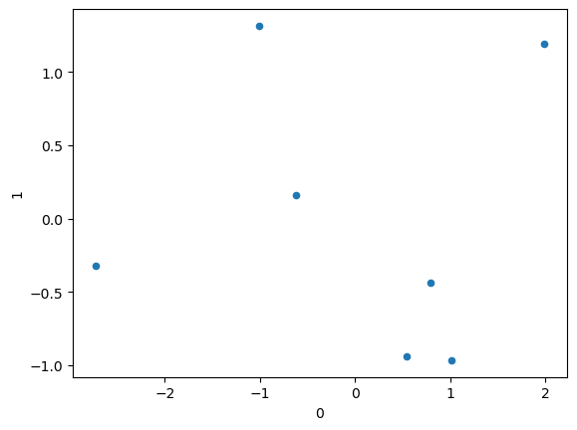
Seeing the result
tx_data.plot.scatter( 0, 1 )
This prints a scatterplot of our data.
We've "projected" it from 3 dimensions into 2.
If two points are close together in this space, they are probably close together in 3d space too.
Notice that we're making good use of space. There isn't an obviously useless dimension.

Slide 51
Understanding the result
One way of understanding this is: imagine if we plot all the points in 3D. We get a cloud of points.
Then imagine that we rotate it around until we get the best "cross-section" that shows us what's going on. We choose an angle that hides the dimension that spreads out the least (since we care about it less).
That's basically what PCA is doing for us.

Slide 52
Questions?

Slide 53
Doing it automatically
All that just so I could show you that SKLearn can do it for you.
from sklearn.decomposition import PCA #we're not doing standardization, but mean offset happens automatically pca = PCA( n_components = 2 ) # I want to keep 2 dimensions pca.fit(data)
That's it.
Now call pca.transform(data) to get a new dataset where the data have been mapped to the new 2-d space.

Slide 54
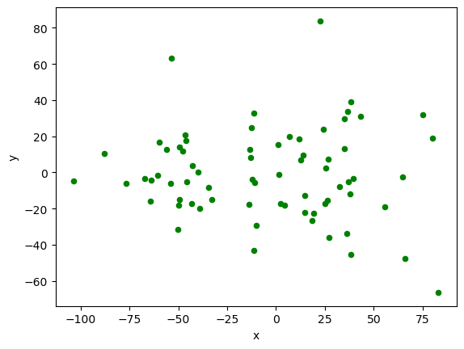
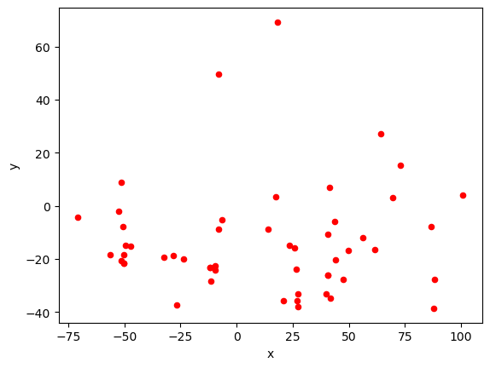
Fun results
I did this with the pokemon data with all 6 stats.
I found that Grass types are more evenly stat-distributed than Fire types.
What patterns can you find?

Slide 55
Pipelines
You can use pipelines too: from sklearn.pipeline import Pipeline pipe = Pipeline([ ('standardize', StandardScaler()), ('pca', PCA(n_components = 2) ) ])
plot_data = pipe.fit_transform(data2)
You could stick a linear classifier in the bottom stage if you wanted...

Slide 56
Takeaways
Make sure you understand the curse of dimensionality
PCA is one way of soliving it. (there are others: LDA, SVD, auto-encoders, etc.)
It's based on the eigenvalues and vectors of the correlation/covariance matrix.
It has the useful result of letting us visualize things in fewer dimensions.
Know how to do it in SKLearn.

Slide 57
Questions?

